Slide 1
NYC CRIMES analysis
BY Data2020: Alex Kan, Tiara Mathur, and Larry Zhang

Slide 2
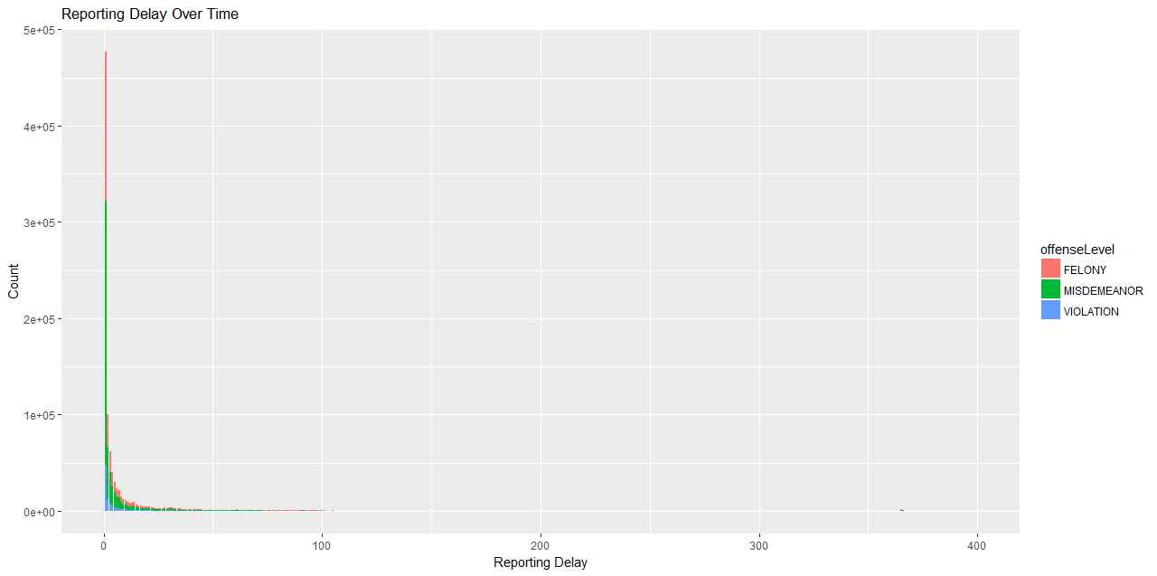
REPORTING DELAYS OVER TIME

Slide 3
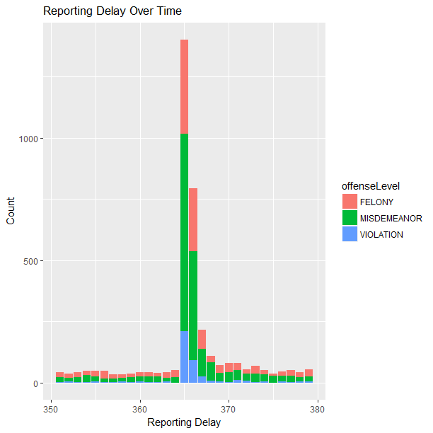

Slide 4
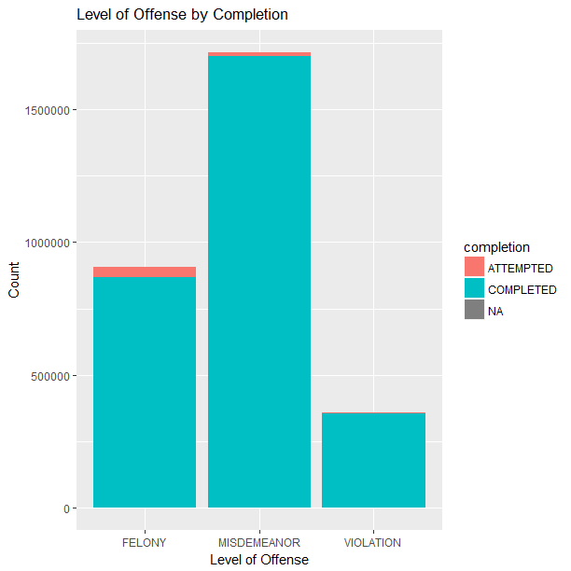
Offense Completion
We find that for all categories, most of the crimes which were reported to police had already been completed. A much smaller percentage of total crimes were reported while in progress. More serious crimes have a greater likelihood of being reported to police while in progress.
4.1% of felonies were reported while being attempted
.83% for misdemeanors
.27% for violations
What could this mean?

Slide 5
Motor Vehicle Theft

Slide 7
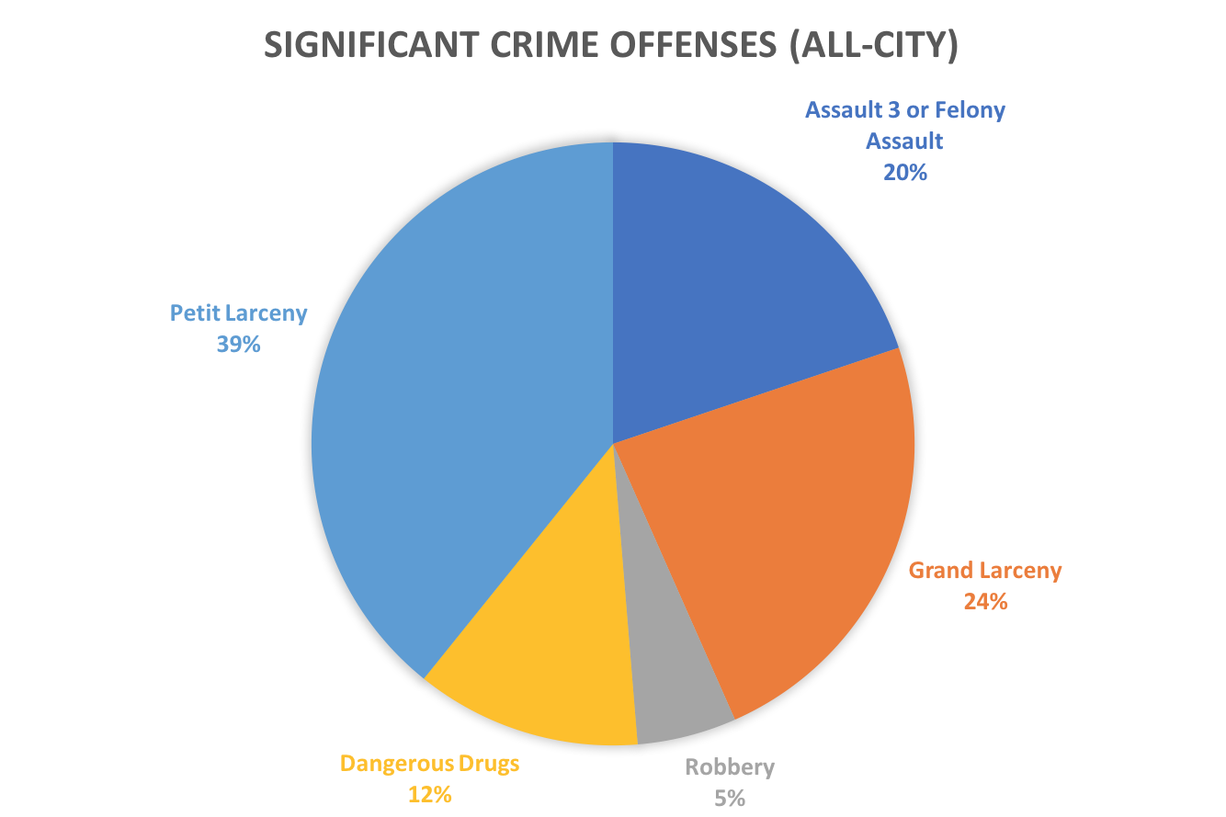
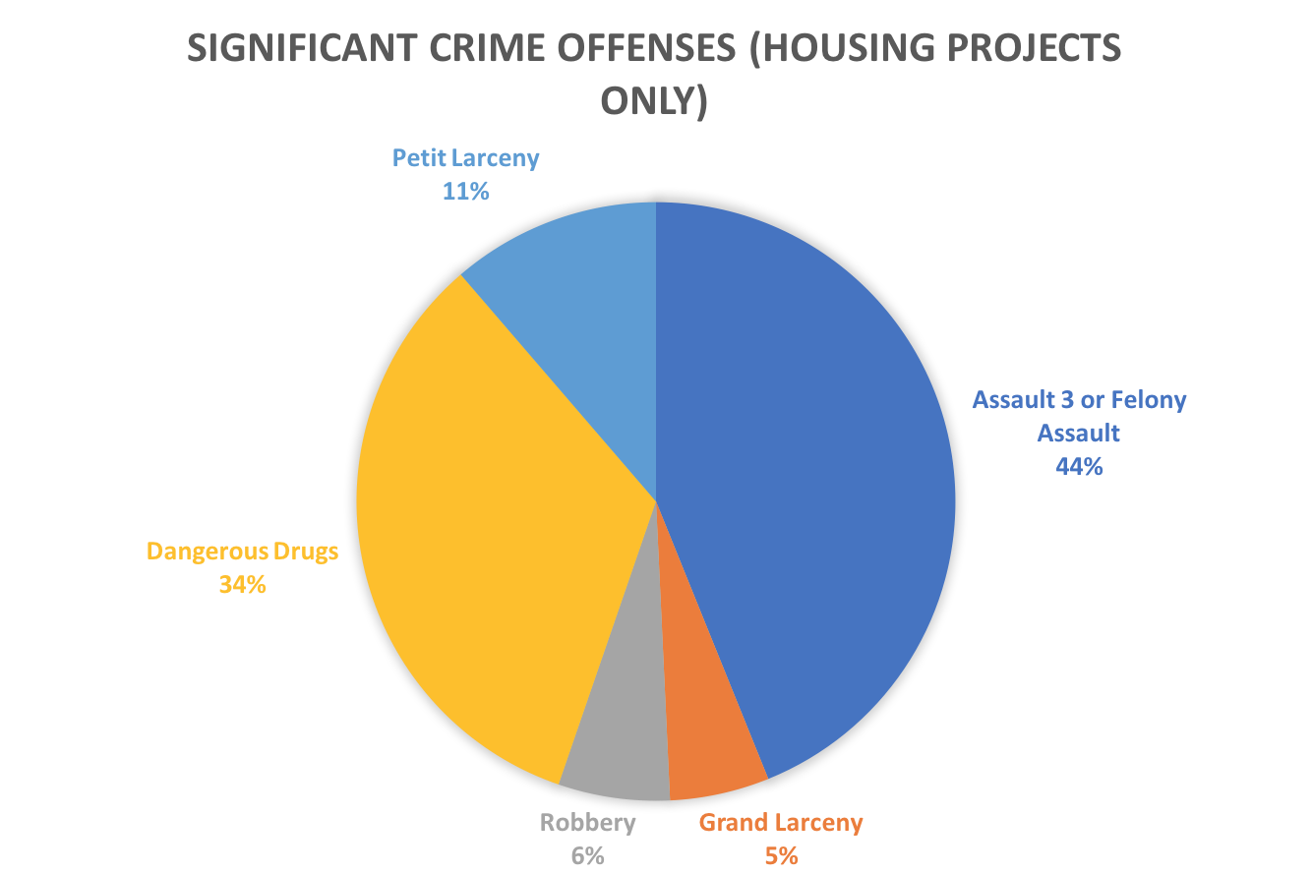
Crime in Public Housing

Slide 8
THANK YOU!!

